Slide 1
City of Pinole
PARKS MASTER PLAN
City Council Meeting
City Council Chambers
2131 Pear Street
February 20, 2024 at 5:00 PM

Slide 2
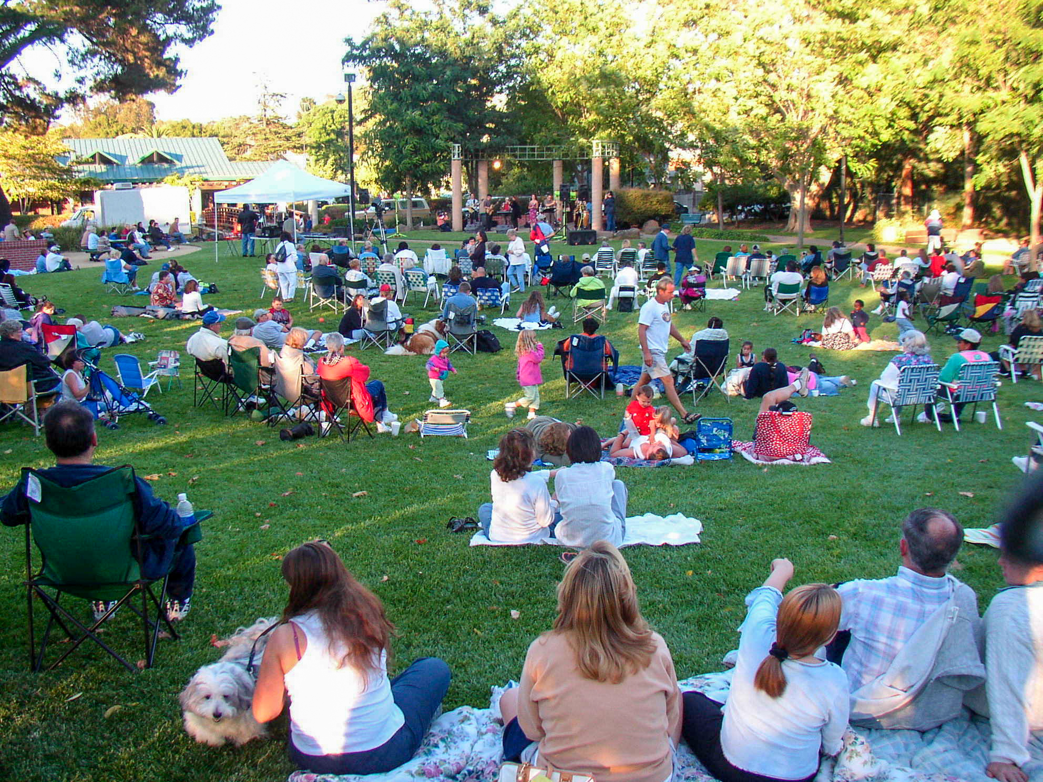
PURPOSE: Parks Master Plan
Guide and implementation tool for the management and development of parks, recreation facilities, and programs.
Identifies local community needs
Offers recommendations to support the Local Pinole Community

Slide 3
PROCESS: Parks Master Plan
Inventory of Existing Conditions
Extensive Community Engagement
Needs Analysis
Recommendations
Funding and Implementation

Slide 4
Timeline:
11 Month Timeline
April 2023 – February 2024
Parks, Facilities, and Program Inventory & Assessment
Extensive Community Outreach
Reporting
Final Presentations
TODAY

Slide 5
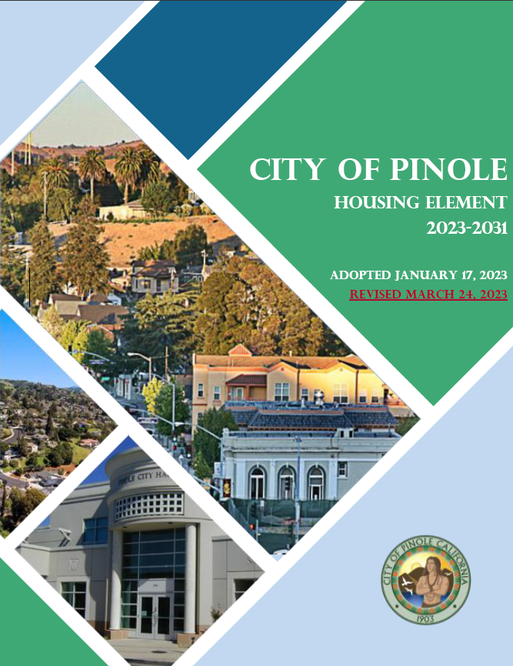
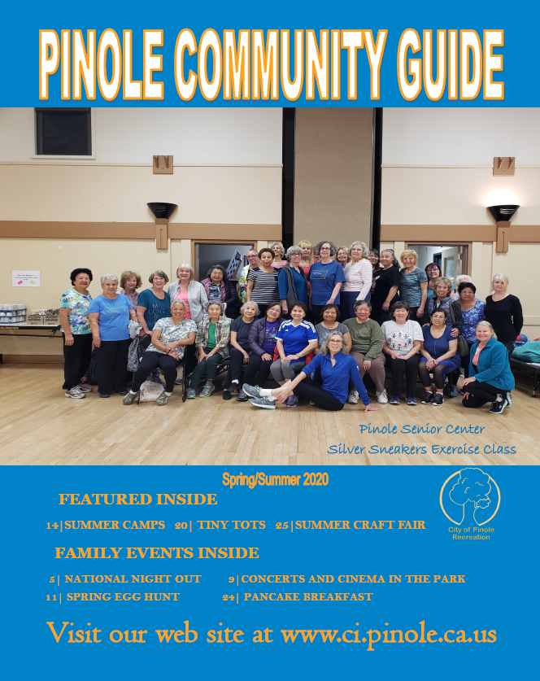
Review Existing Documents

Slide 6
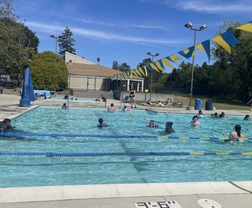
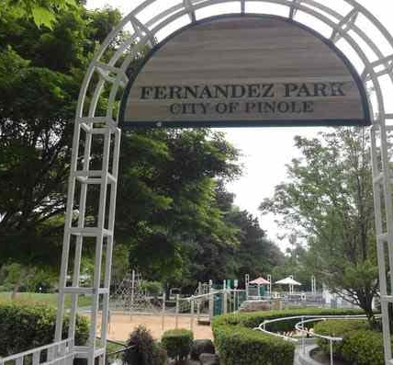
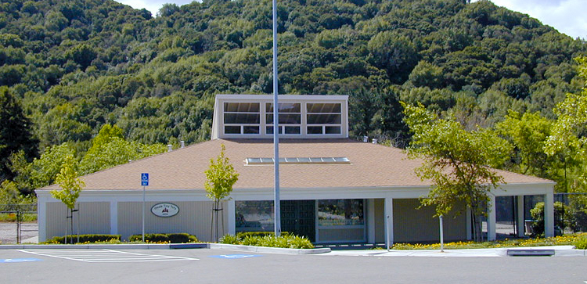
Inventory of Parks & Facilities
14 City Parks (including Tennis Courts)
1 Aquatics Facility/Pinole Swim Center
4 Community/Recreation Centers
Community Playhouse
Pinole Senior Center
Pinole Tiny Tot Center
Pinole Youth Center

Slide 7
v

Slide 8
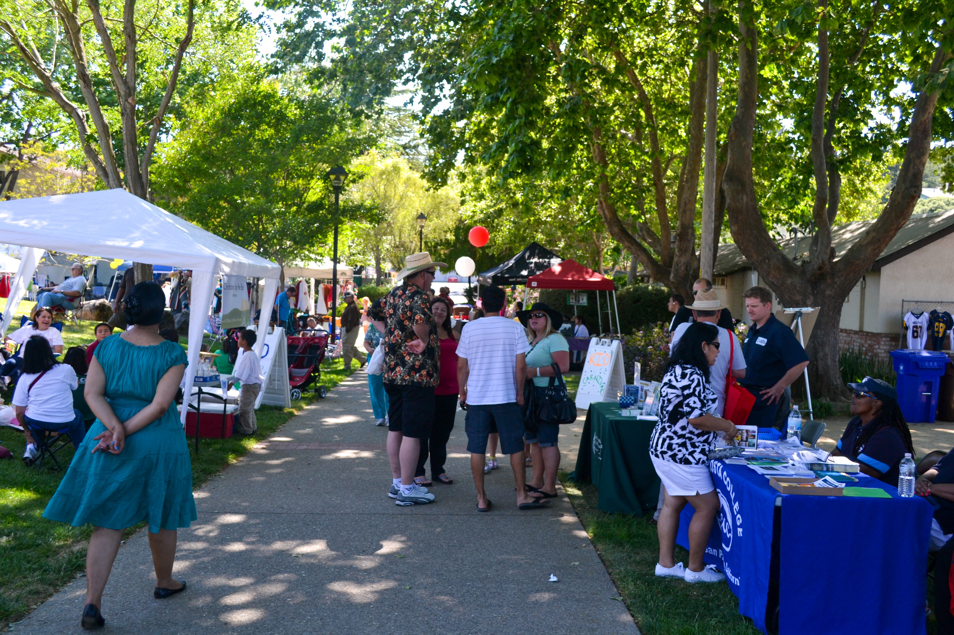
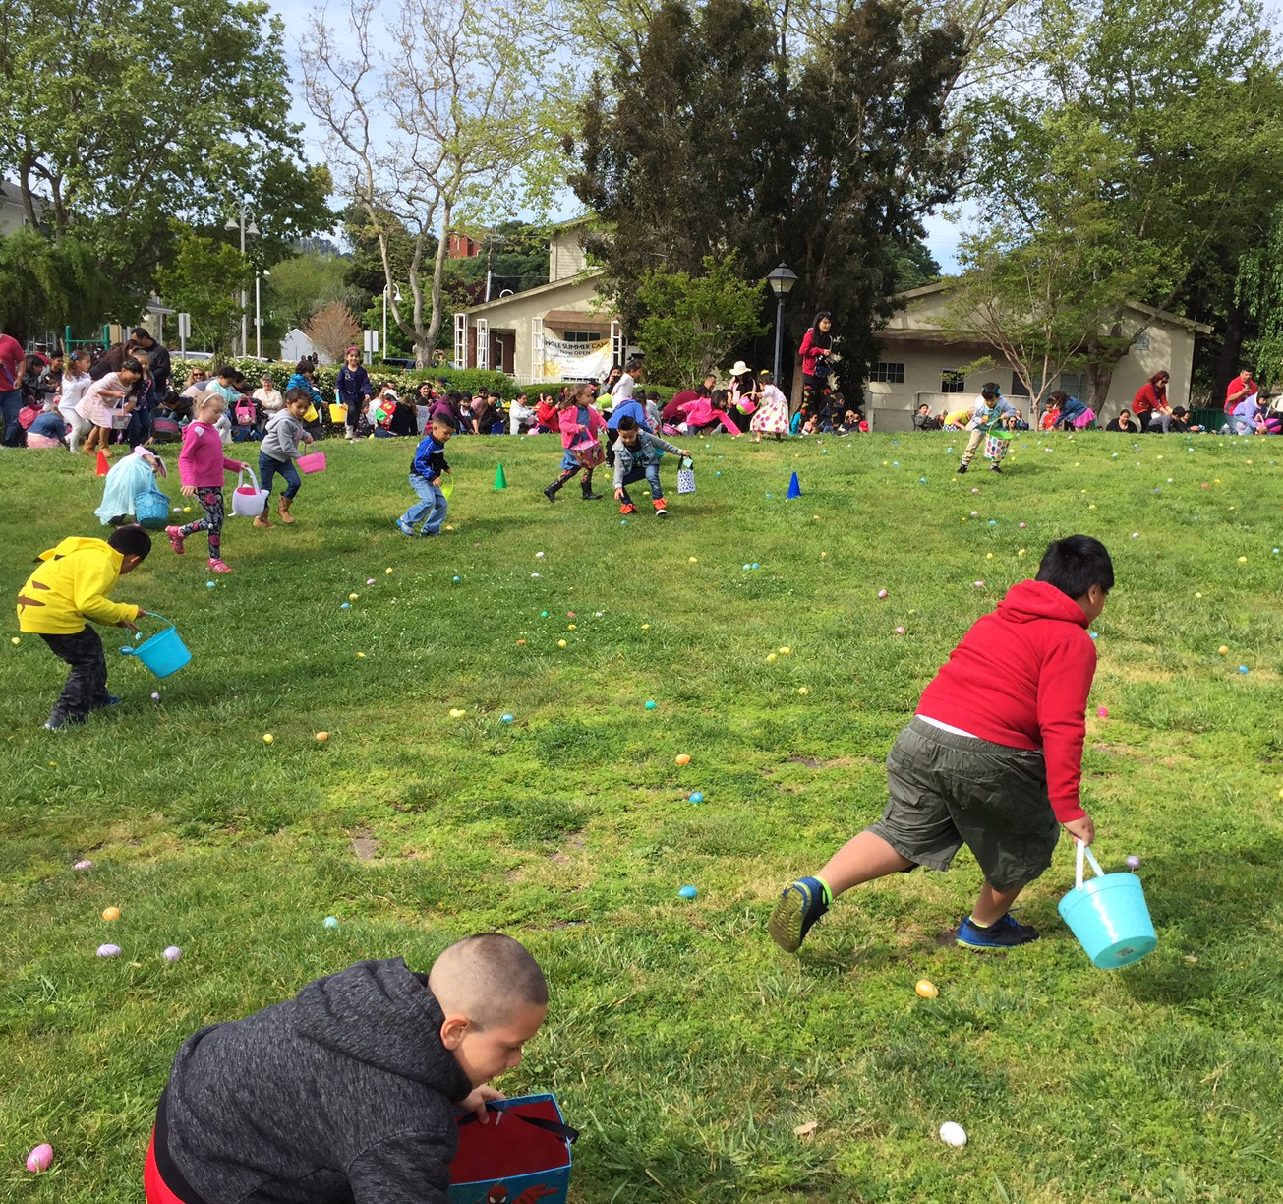
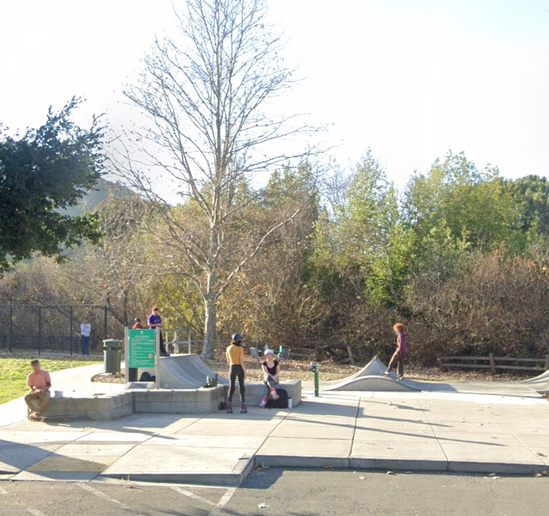
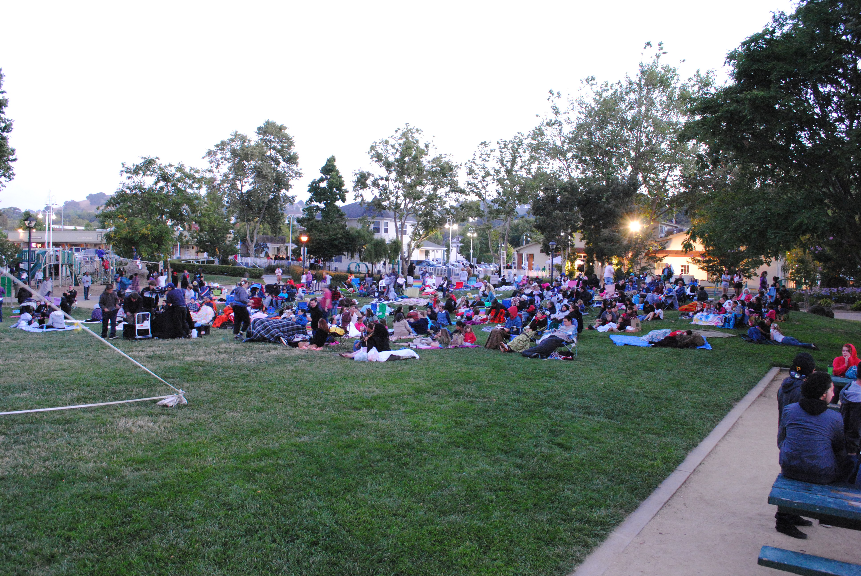
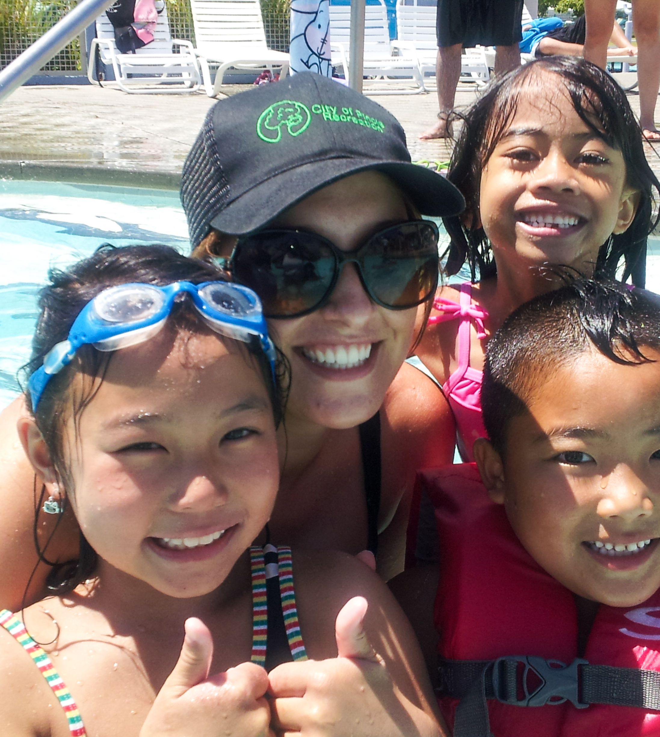
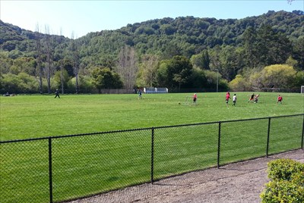
Inventory of Programs
Aquatics
Facility Management/Rentals
Performing Arts
Senior Programs
Special Events
Tiny Tots/Youth/Teen Programs

Slide 9
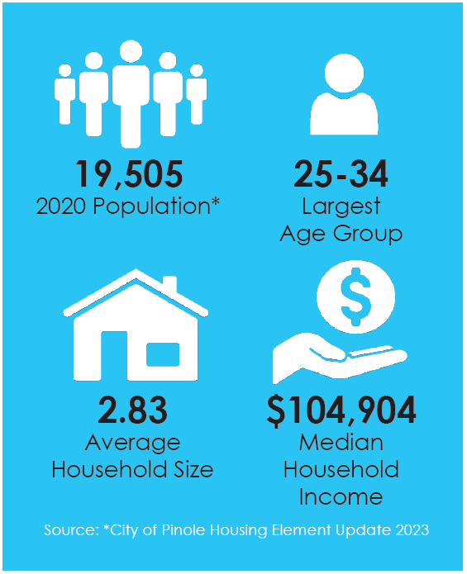
Demographics
2020 TOTAL POPULATION:
19,505

Slide 10
Community Outreach & Engagement
Stakeholder Interviews: 12
Website Total Views: 2,498
Feedback Submittals: 229
Workshop 1 Survey: 164
Workshop 2 Survey: 138
Outreach numbers as of 1/10/24

Slide 11
Participation Distribution
Workshop 1
Workshop 2
Feedback

Slide 12
Stakeholder Interviews
PARK / FACILITY NEEDS
PROGRAM NEEDS
Ballfield/Softball Field Improvements
Community Pool
Dog Park
Pickleball Court
Picnic Areas/BBQs
Pinole Creek
Playgrounds
Restroom Improvements
Soccer Field Improvements
Trails
After School Programs
Aquatic Programs
Arts Class
Computer Class
Marketing/ Advertising of Services Offered
Sewing Class
Teen Activities

Slide 13
Parks Master Plan Feedback Comments Summary
Facilities Word Cloud
Programs Word Cloud
Data as of 1/10/23

Slide 14
Workshop #1 Summary
Q1
Q2
Q3
What are the most important community characteristics?
What are issues or trends that may be negatively impacting characteristics?
What role can Community Services Dept. play to address these issues?
Access to the bay/location
Community activities
Diversity
Parks and outdoor spaces
Proximity to shopping and amenities
Safety
Small town atmosphere
Walkability
Community engagement
Economic development concerns
Environmental issues
Maintenance and upkeep
Recreation and sports facilities
Safety
Traffic and transportation
Communication and transparency
Community engagement and outreach
Economic development
Environmental initiatives
Infrastructure and traffic
Park maintenance and enhancement
Public safety

Slide 15
Workshop #1 Summary
Q4
Park most visited?
Bayfront Park
Dog Park
Fernandez Park
Pinole Senior Center
Pinole Valley Park
Q5
Why do you visit this park the most often?
Organized recreation classes or programs led by an instructor
Organized sports (i.e. baseball, basketball, soccer, softball, volleyball) that are led by an instructor or coach
Playground play
Recreation activity like walking, picnicking, nature viewing, or dog walking
Self-led (no instructor) sports or recreation activities like exercising, jogging, running, pickleball, tennis, or swimming

Slide 16
Workshop #1 Summary
Q6
Park feature or recreation facility to add or improve?
Q7
Program, class, activity or service to add or improve?
Baseball Field Improvements
Bayfront Improvements
Bike Lanes/Trails
Dog Park Improvements
Garden/Community Garden
Pickleball Court
Picnic Shelter
Pool Improvements
Playground Improvements
Soccer Field Improvements
Trail Improvements/Connections
After School Program
Bike Events/Program
Festivals/Concerts/Family Events
Gardening Class
Nature Education Class (Fishing, Birding)
Outdoor Exercise/Yoga/Tai Chi
Pickleball Class
Soccer Program
Swimming Lessons
Volunteer Clean Up/Planting
Youth Sports / Teen Activities

Slide 17
Workshop #2 Summary
Q1
Park feature or recreation facility to add or improve?
Q2
Program, class, activity or service to add or improve?
Bike Lanes/Trails
Library (modernize)
Modernize & Upgrade Parks
Natural Open Space (more trees, native vegetation)
Pinole Creek (improve access, clean up)
Trail Improvements/Connections
Waterfront/Bayfront Park Improvements
Adult Recreation Activities
After School Program
Aquatic Programs
Festivals/Concerts/Family Events
Food Trucks/Partner with Local Restaurants (at city events)
Revitalize Downtown Area

Slide 18
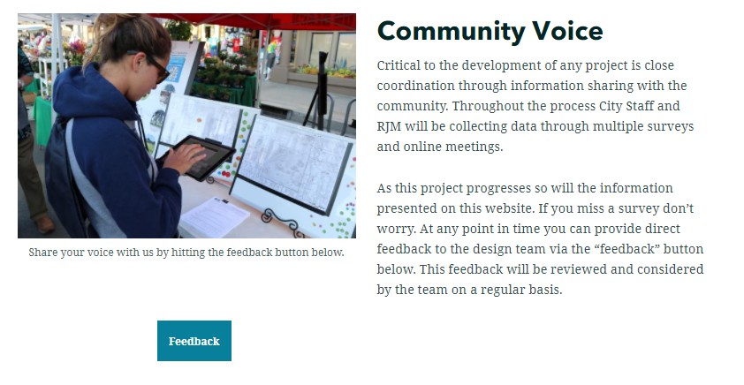
Next…Take the Survey!
www.PinoleParksMasterPlan.com
September 8th through September 24th
https://arcg.is/yLL9n
Project Website (over 2,400 views) and Feedback Comments (229)

Slide 19
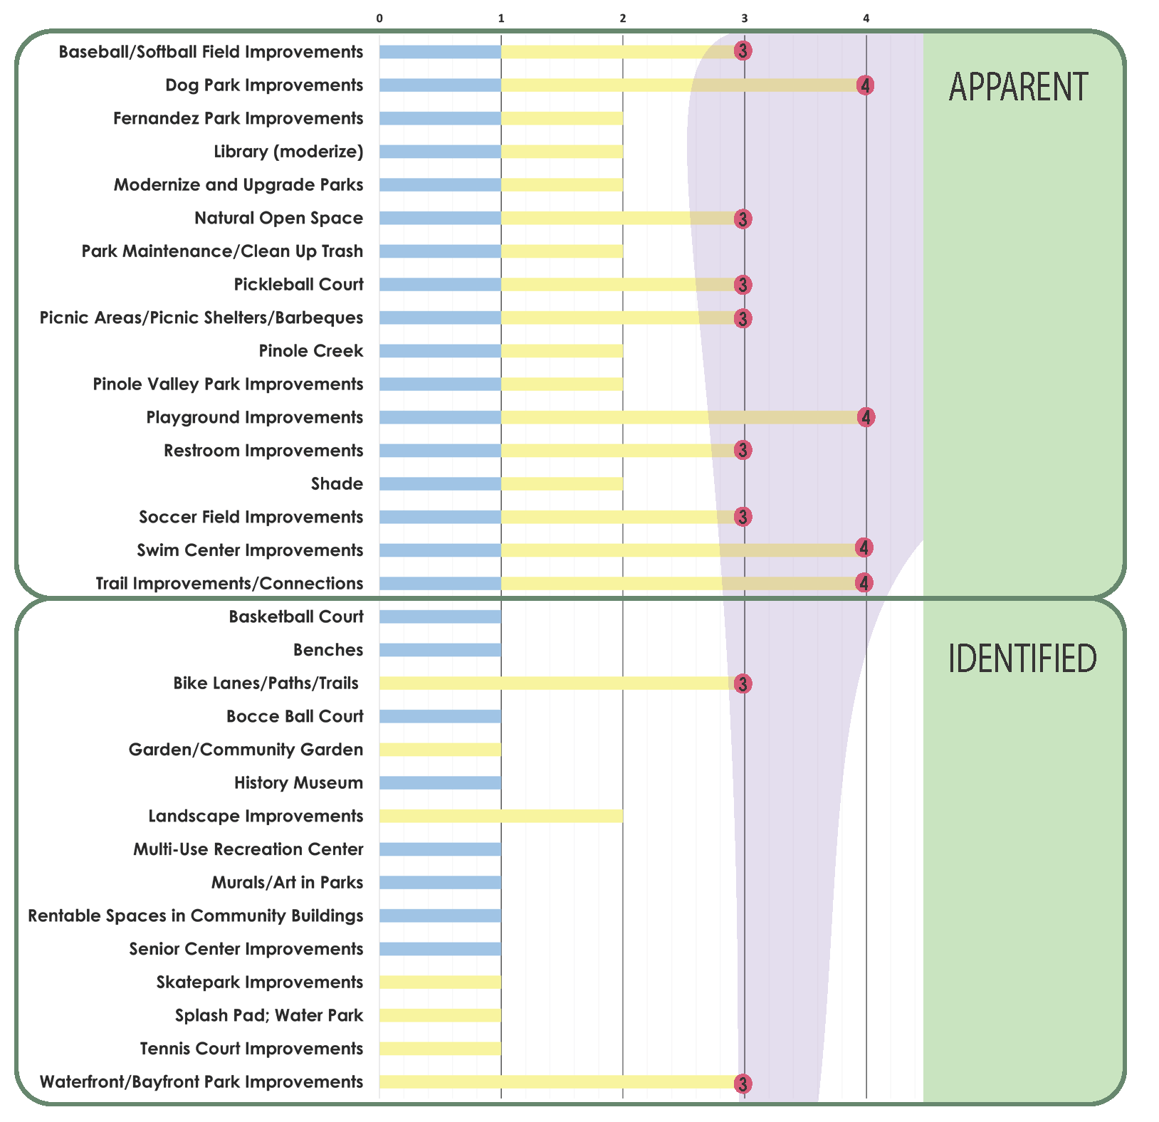
Community Facility Needs - Prioritization
Small Group
Stakeholder Interviews
Public / Community
Workshop 1 / Workshop 2
/ Feedback Comments
Area of maximum community impact

Slide 20
Community Facility Needs - Prioritization
Baseball / Softball Field Improvements
Bike Lanes / Paths / Trails
Dog Park Improvements
Natural Open Space
Pickleball Court
Picnic Areas / Picnic Shelters / Barbeques
Playground Improvements
Restroom Improvements
Soccer Field Improvements
Swim Center Improvements
Trail Improvements / Connections
Waterfront / Bayfront Park Improvements
Area of maximum community impact

Slide 21
Community Program Needs - Prioritization
Small Group
Stakeholder Interviews
Public / Community
Workshop 1 / Workshop 2
/ Feedback Comments
Area of maximum community impact

Slide 22
Community Program Needs - Prioritization
After School Program
Aquatic Program
Gardening / Grow Food Class
Nature Education Class (fishing, birding, hiking)
Teen and Tween Activities
Festivals / Concerts / Family Events
Area of maximum community impact

Slide 23
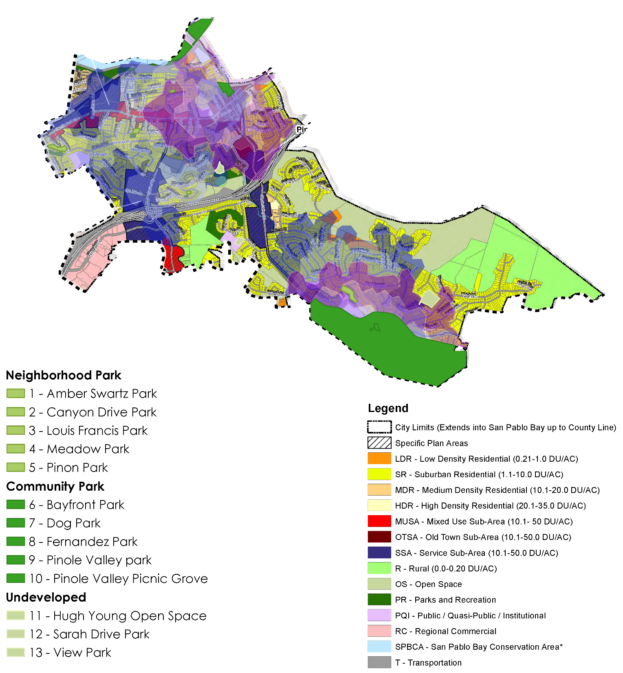
Acreage and Service Area Gap Analysis
54.16 Acres of Developed City Parkland
= 2.78 acres per 1,000 residents
Not including…..
248 Acres of Undeveloped Parkland

Slide 24
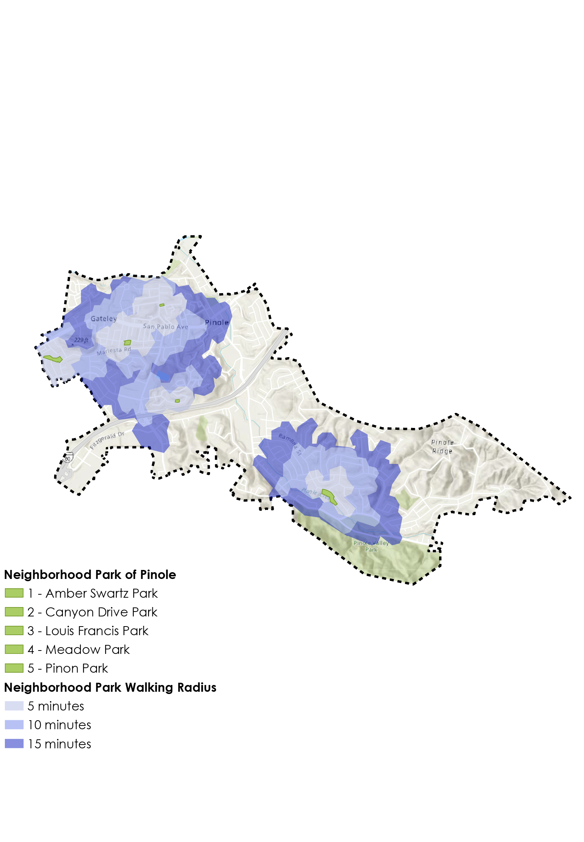
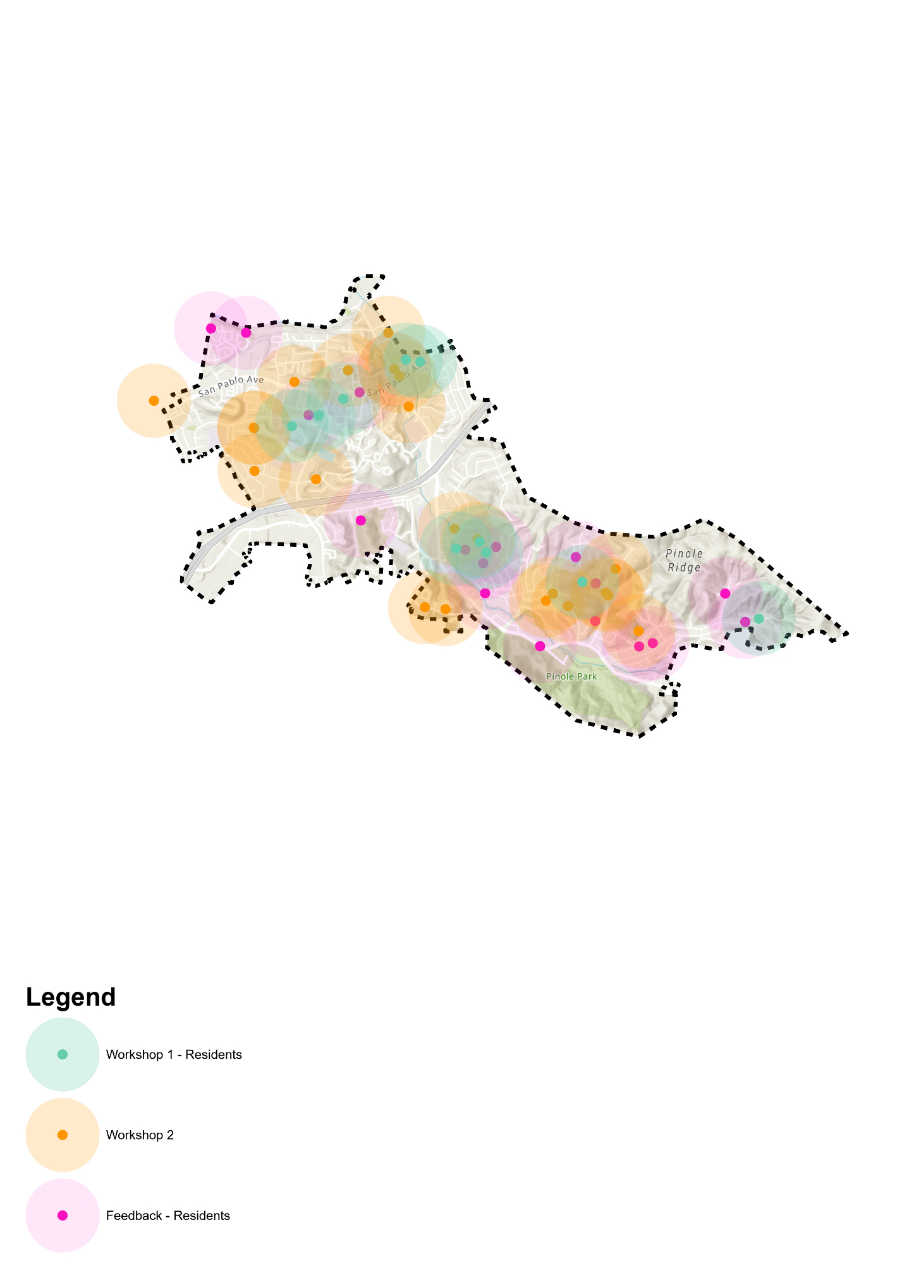
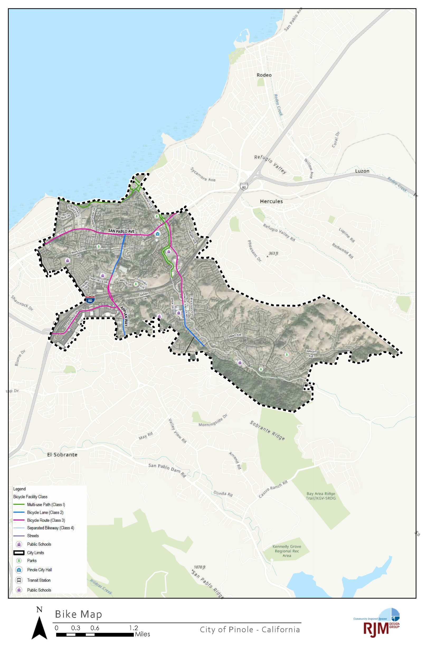
GIS Mapping Analysis
Neighborhood Parks Drive Radius
Dog Park Improvements
Existing Bike Trails

Slide 25
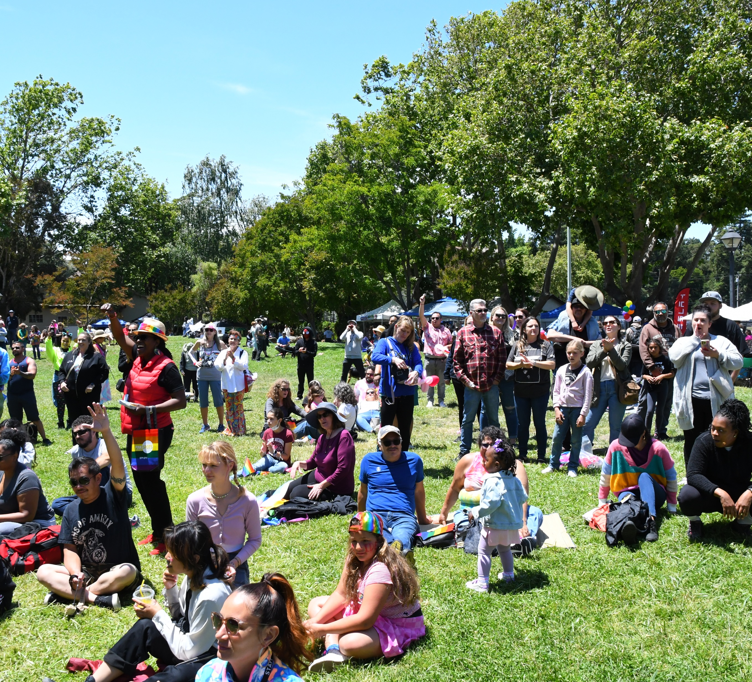
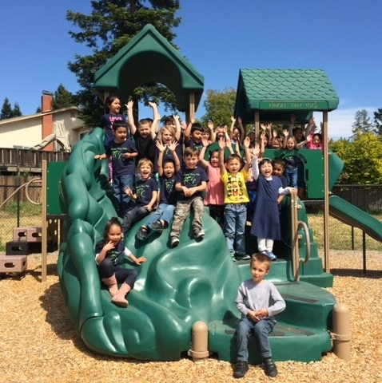
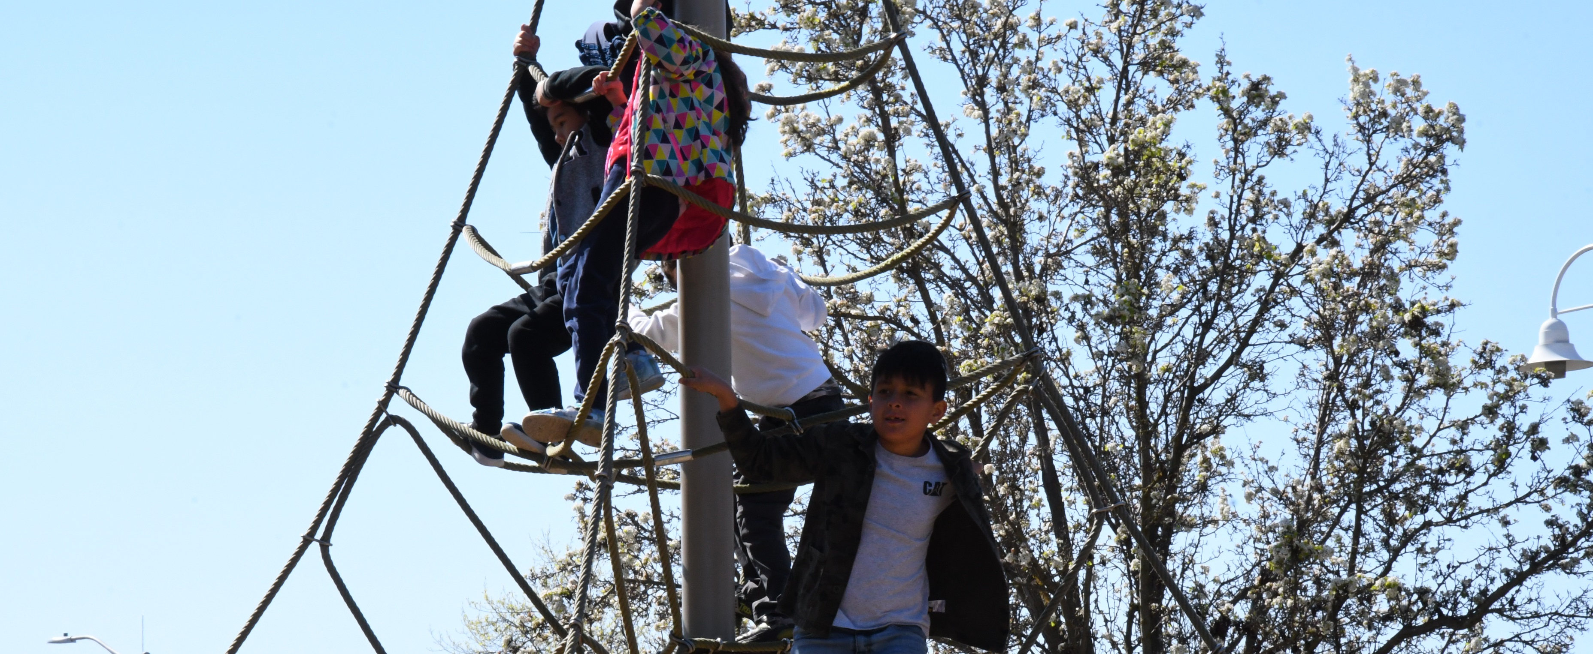
Key Strategies & Recommendations

Slide 26
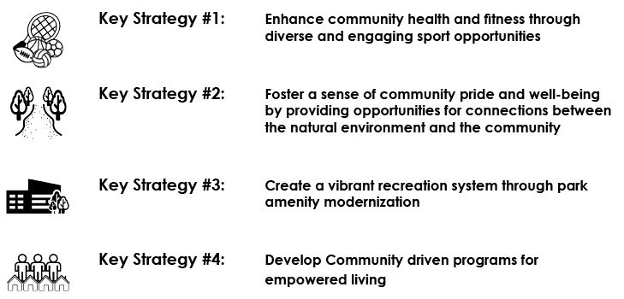
Four Key Strategies

Slide 27
Key Strategy #1: Enhance community health and fitness through diverse and engaging sport opportunities
Pickleball Court
Baseball/Softball Field Improvements
Swim Center Improvements
Soccer Field Improvements

Slide 28
Key Strategy #2: Foster a sense of community pride and well-being by providing opportunities for connections between the natural environment and the community
Natural Open Space
Trail Improvements / Trail Connections / Bike Lanes / Bike Paths / Bike Trails
Waterfront / Bayfront Park Improvements

Slide 29
Key Strategy #3: Create a vibrant recreation system through park amenity modernization
Dog Park Improvements
Playground Improvements
Restroom Improvements
Picnic Area / Picnic Shelter / Barbeques

Slide 30
Key Strategy #4: Develop community driven programs for empowered living
After School Programs
Aquatics Programs
Teen and Tween Activities
Nature Education Class (fishing, birding, hiking)
Gardening / Grow Food Class
Festivals / Concerts / Family Events

Slide 31
Maintenance Recommendations
Turf Maintenance
Shrub and Groundcover Maintenance
Rodent / Pest Control
Tree Care
General Park Maintenance
Hardscape
Maintenance
Playground Inspections
Irrigation System Maintenance
Sports Field / Court Light Maintenance
Tennis and Basketball Courts
Picnic Shelters, Gazebos, and Reservation Areas

Slide 32
Funding and Implementation
Funding Sources for Parks and Recreation
Current and Projected Capital Project Costs

Slide 33
Funding Sources
^{Developer Impact Fees}
^{Developer Special Agreement}
^{General Fund/CFD’s/LMD’s}
^{Non-profit Organization}
Public/Private Partnerships, Concessions
^{Grants-CDBG}
Grants-Public Agencies & Private Foundations
^{Corporate Sponsorships}
^{Certificates of Participation}
^{Bonds}
^{Sales Tax}
^{Sale/Lease of Surplus Land}
^{User Group Contributions}
School District Joint-use Contributions
^{Other Dedicated Taxes}
General Fund for Parks, Recreation, and Maintenance
Nexus Study
Adequate Staff / Personnel
Developer Agreements/Park in Lieu Fees

Slide 34
Current and Projected Capital Project Costs
$4.3 million in current planned park and facility improvements
$17.4 million in projected unplanned Parks Master Plan park and facility recommendations

Slide 35
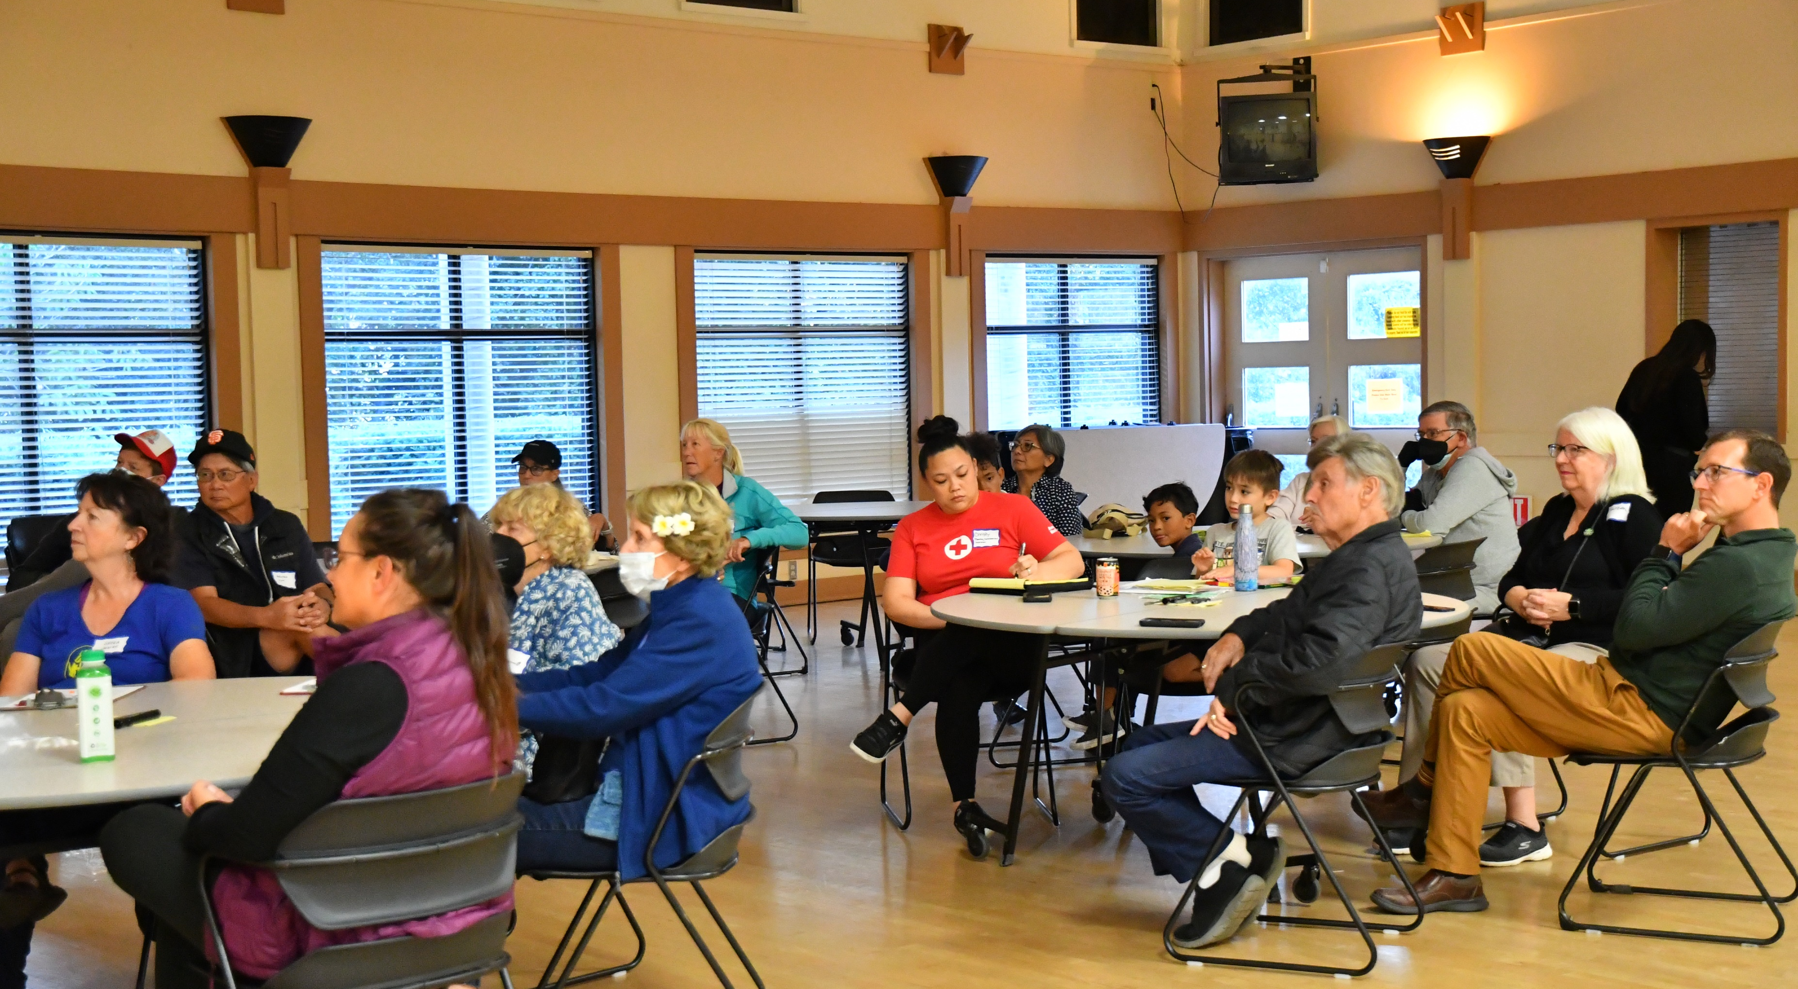
Parks Master Plan
Questions?

